Slide 1
Data Analysis: Red Bull Account Sales

Slide 2
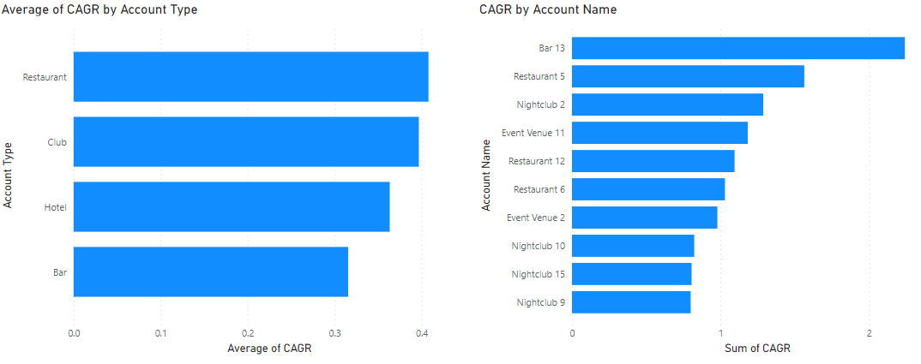
Sales Growth by Account and Account Type
Graph(s) of trends and data for sales by account and / or account type

Slide 3
Best and Worst Performing Accounts by Account Type (5 Year CAGR)
Top 2 Accounts
Bar | Restaurant | Club | Event Venue
Bar 13 | Restaurant 5 | Nightclub 2 | Event Venue 11
Bar 14 | Restaurant 12 | Nightclub 10 | Event Venue 2
Bottom 2 Accounts
Bar | Restaurant | Club | Event Venue
Bar 7 | Restaurant 8 | Nightclub 11 | Event Venue 1
Bar 15 | Restaurant 11 | Nightclub 8 | Event Venue 4

Slide 4
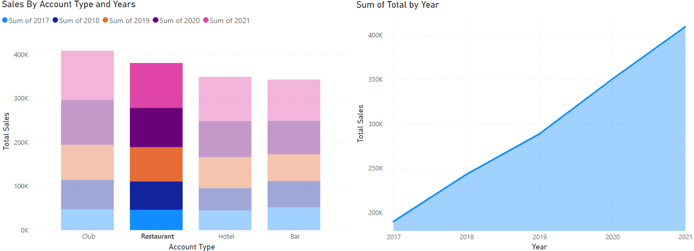
Total Sales by Account Type and Year
Graph(s) of trends and data for total sales by account type and year…

Slide 5
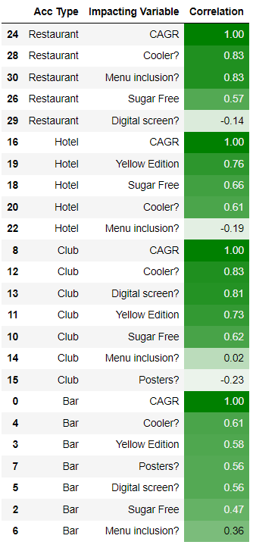
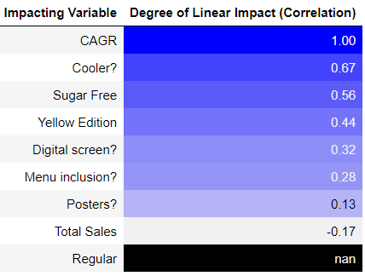
Observations and Key Takeaways
Observations
The lowest CAGR scoring establishments was mainly due to their lack of product availability and lack of marketing efforts.
The figure on the left highlighted in blue shows the correlation between different products and marketing tactics on CAGR.
The figure on the left highlighted in green is the correlation between different products and marketing tactics on CAGR taking in account different account types.
Recommendation
All restaurants should add coolers, and menu inclusions as marketing tactics as well as offer the sugar free version.
All hotels should add coolers as marketing tactics as well as offer the sugar free and Yellow Edition products.
All Clubs should add coolers, digital screens as marketing tactics as well as offer the sugar free and Yellow Edition products.
All Bars should add coolers, digital screens and posters as marketing tactics as well as offer the sugar free and Yellow Edition products.

